Slide 1
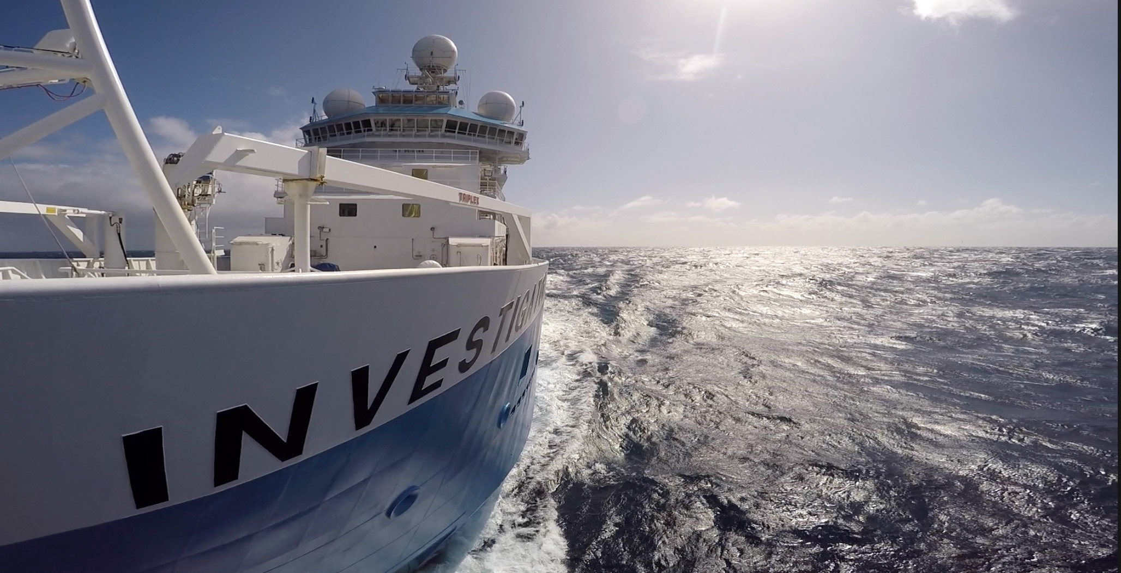
OBIS Data flows
Dave Watts
8 March 2017
Data Centre, O&A

Slide 2
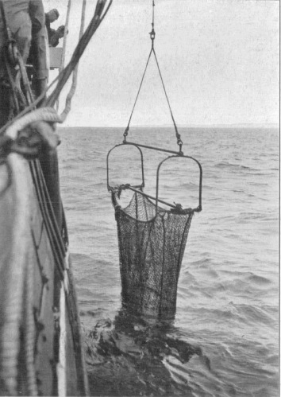
Outline
The OBIS network
Tools to publish data
Data gaps
Interaction with other networks
Future bits

Slide 3
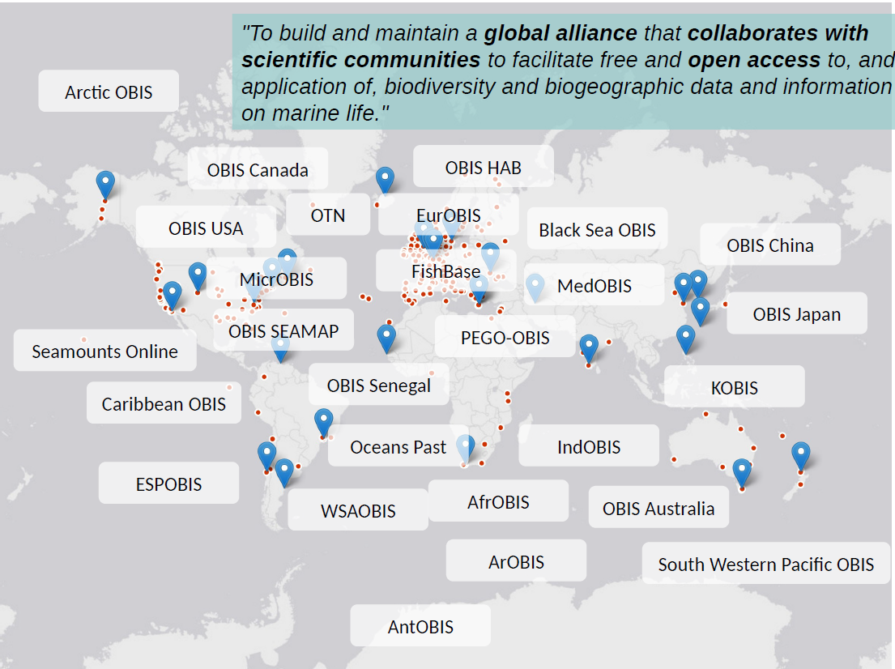
The network

Slide 4
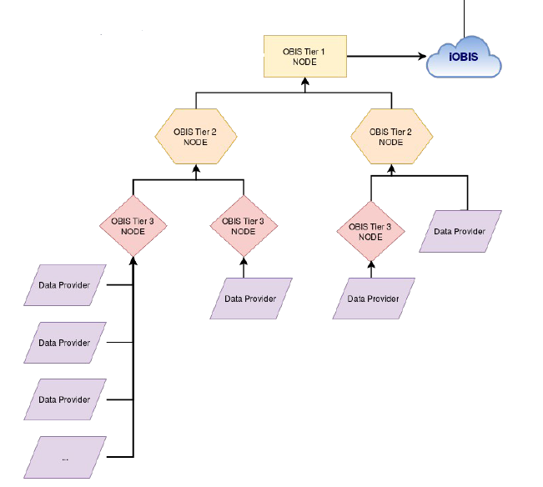
The data flow structure
OBIS-AU

Slide 5

Biological data (first attempt)
Distributed Generic Information Retrieval (DiGIR)
Very old application built circa 2003 in PHP.
To deliver species occurrence data from COML to OBIS/GBIF
Delivers data in DwC xml format, via query
Performance fine up to 50,000 records but awful after that
  Six million records from Poland to Copenhagen took 24 hours
To be fair, servers etc not as fast as now

Slide 6

Biological data (second attempt)
Integrated Publishing Toolkit (IPT)
Started prototype circa 2008
Delivers data in DwC tagged csv via a datafile download
Performance fine - upto millions of records. GBIF has 715 million.
Connects to any database or a csv import file.
Crossmatch to DwC vocabs for export.

Slide 7
Data standards
Darwin core DwC – http://rs.tdwg.org/dwc/terms/
vocabs with definitions, examples, suggested values
EML - Ecological Metadata Language (EML) is a metadata specification developed by the ecology discipline and for the ecology discipline.
Developed into IPT circa 2009
very human readable!

Slide 8
Key elements in DwC
To publish to OBIS, the following are expected
scientificnameId – should hold WoRMS LSID of taxa – allows verification of data providers species name
e.g Wandering Albatross urn:lsid:marinespecies.org:taxname:212583
Other LSIDS can be used e.g. from Australian Faunal Directory
occurrenceStatus – values of ‘present’ or ‘absent’
occurrenceId – unique value within an IPT resource and needed in links to the EventCore data.

Slide 9
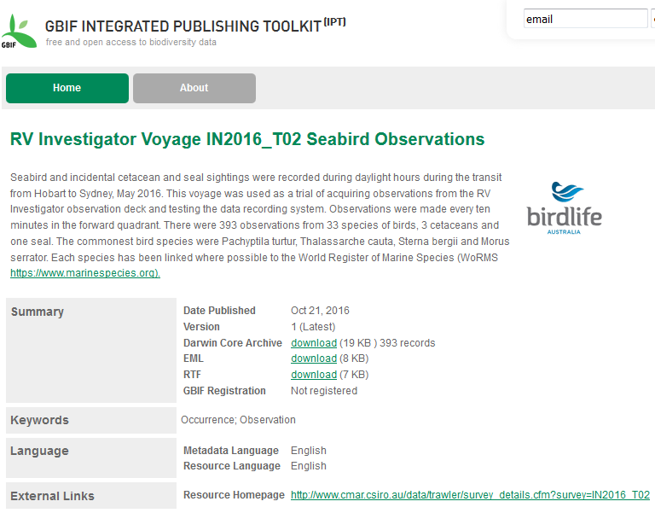
Biological data -IPT

Slide 10
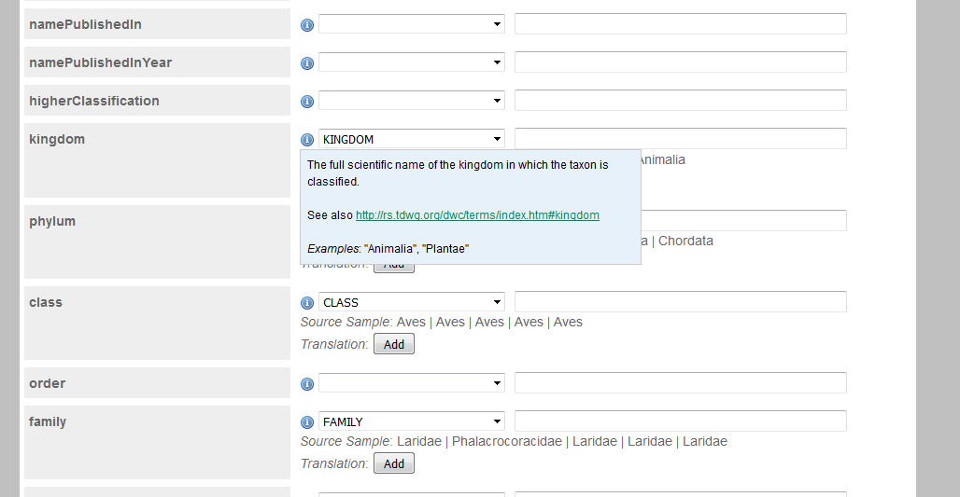
IPT – Matching to TDWG DwC vocabs

Slide 11
Biological data -IPT
Pros
  scalable - limited only by file size
  matches to vocabs in a very robust and friendly manner
  if using a database, can support SQL filter on table – reduce use of views
  single zip containing all data, metadata (EML)
  data versioning
  For OBIS, backbone taxonomy is WoRMS
  Limited impact of data provider’s servers
  Extensible by downloading new schemas
Cons
  Custodian must actively ‘publish’ if new data or revisions
  Only CSV data

Slide 12
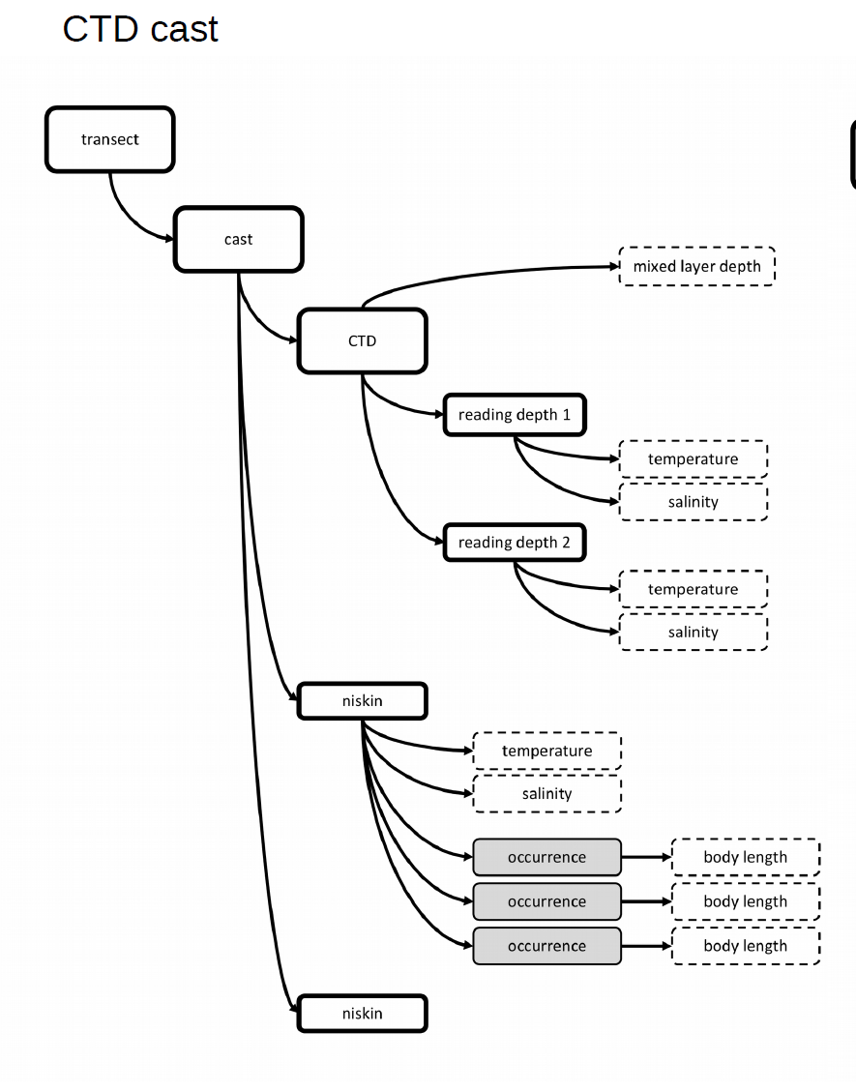
OBIS-ENV-DATA project
Purpose: to add environmental and other context data to DwC data
Designed to deal with CTD casts, trawl events and related catch composition, existing species occurrence records with environmental measurements, e.t.c.

Slide 13
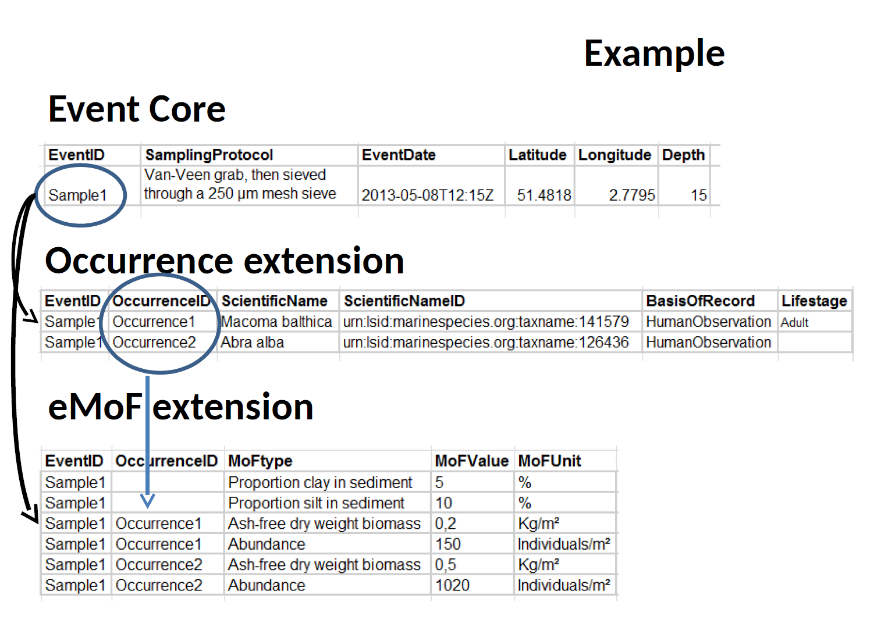
OBIS-ENV-DATA project

Slide 14
Existing OBIS services
OGC Geoserver instance
http://www.iobis.org/geoserver
Two layers - OBIS:drs_with_woa, OBIS:points_ex
R packages
https://github.com/iobis/robis
- occurrence records and mapping
- species checklist

Slide 15
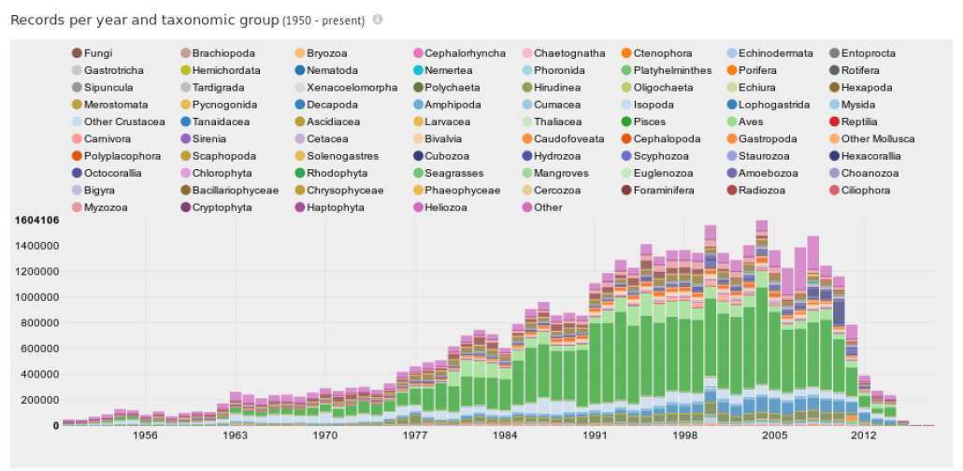
Current data – by year

Slide 16
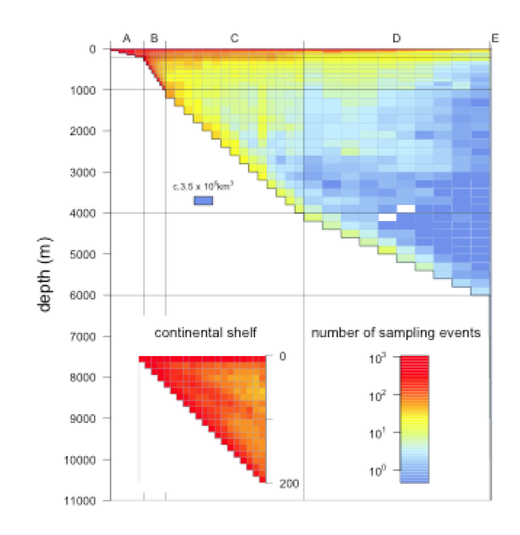
Current data – by depth
Number of sampling days per depth volume

Slide 17
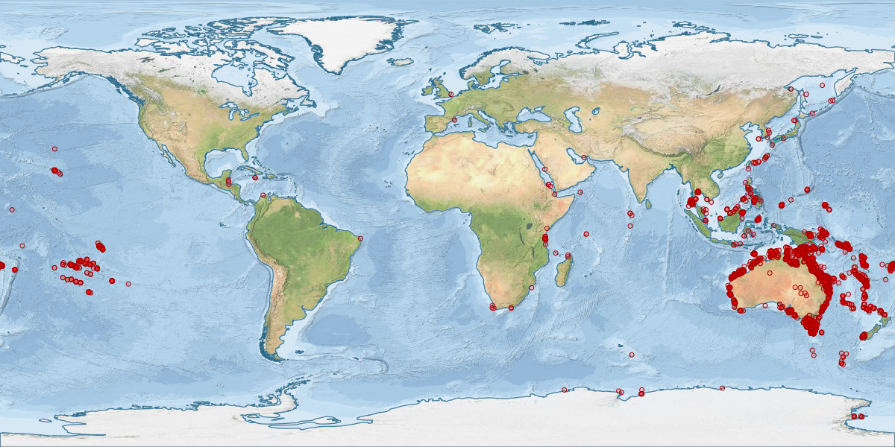
Why an aggregator?
Queensland Museum Porifera (aka sponges)

Slide 18

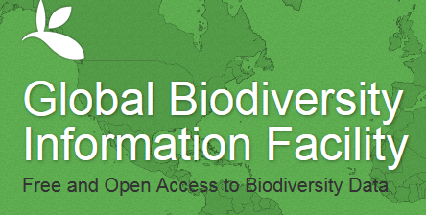

GBIF the elephant in the room
marine data marked as
'marine, harvested by iOBIS'
OBIS Tier 2
OBISAU
IPT
all data if registered
Data exchange
by csv upload
Data providers (mainly OZCAM)

Slide 19
Where to for OBIS
Near real-time data loading and data quality feedback
Ability to handle the ENV data model
Active API development
Perhaps fossil records (land-based data, sediments - forams)
Perhaps private data (e.g. sensitive)
Need deep water records
Need BNJ records
Need contemporary records

Slide 20
Questions
Oceans and Atmosphere / Data Centre
  Dave Watts
  Node manager OBIS Australia
    t +61 3 6232 5062
    e dave.watts@csiro.au
    w www.obis.org.au
O&A Data Centre

